Slide 1


Difference between Private Limited and Limited Companies
Understanding the key differences between private limited and limited companies is crucial for entrepreneurs and business owners when choosing the right company structure for their organization. This presentation will explore the distinct features, advantages, and considerations for each type of company.
by Sahil S. Kadam (Roll no. 150096724124)

Slide 2
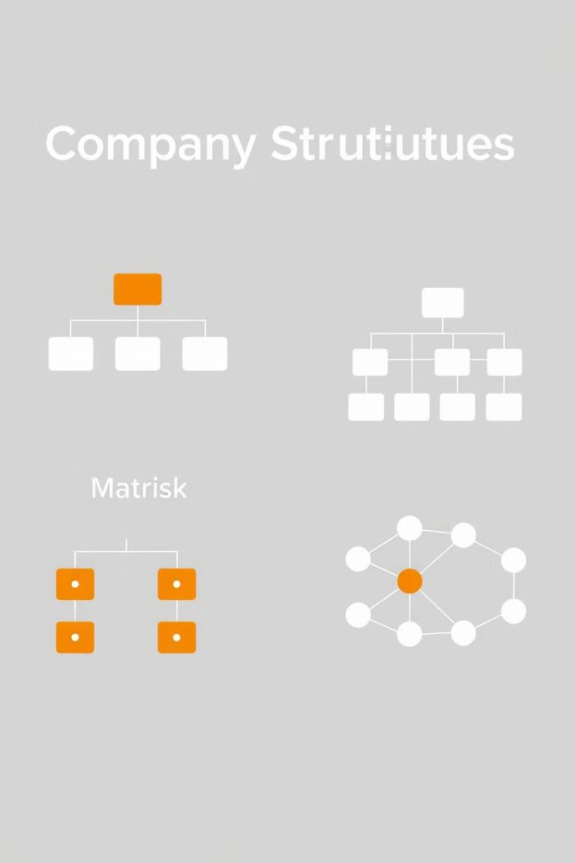
Introduction to Company Types
1
Private Limited Company
2
Limited Company
A company with shares that can be publicly traded, with a larger shareholder base.
A company with a limited number of shareholders, typically close friends or family members.

Slide 3
Key Features of Private Limited Companies
Ownership
Transferability
Regulation
Shares are held by a limited number of private individuals or entities.
Shares are not freely transferable, usually requiring consent from other shareholders.
Less stringent regulatory requirements compared to public limited companies.

Slide 4

Key Features of Limited Companies
1
Public Shares
Shares can be publicly traded on a stock exchange.
2
Regulations
Stricter regulatory requirements, including annual filings and audits.
3
Transparency
Higher level of financial and operational transparency for shareholders and the public.

Slide 5

Advantages of Private Limited Companies
Flexible Management
Confidentiality
Private limited companies have greater flexibility in decision-making and management.
Private limited companies enjoy more confidentiality compared to public companies.
Tax Benefits
Easier Funding
Private limited companies may be eligible for certain tax advantages.
Private limited companies can more easily obtain funding from private investors.

Slide 6





Advantages of Limited Companies
Scalability
Prestige
Liquidity
Regulation
Limited companies have better access to public capital markets for growth.
Being a public limited company can enhance a company's reputation and credibility.
Shareholders of limited companies can more easily buy and sell their shares.
Stricter regulations can provide greater investor protection and transparency.

Slide 7




Choosing the Right Company Structure
Assess Goals
Determine your company's growth plans, capital needs, and ownership structure.
Consider Regulations
Understand the legal and compliance requirements for each company type.
Evaluate Advantages
Weigh the benefits and drawbacks of private limited vs. limited companies.

Slide 8

Conclusion
Choosing the right company structure is a critical decision that can have long-term implications for your business. By understanding the key differences between private limited and limited companies, you can make an informed choice that aligns with your strategic goals and positioning.
Thank you for your time and attention.

